Slide 1


Citation Networks Evolution Using Dynamic Network Embeddings
Shay Bistrizky
Prof. Zeev (Vladimir) Volkovich
206622086
Avishay Bar
Dr. Renata Avros
316165984

Slide 2
Project Overview
Welcome to our exploration of how citations evolve across scholarly publications. In this project, we aim to classify and analyse citation behaviours within dynamic citation networks. By understanding these patterns, we can gain insights into how knowledge propagates, how influential research emerges, and how academic discourse evolves over time.
Perform
Analyze
Perform citation classification for deeper scholarly insights
Develop
Analyze dynamic network embeddings
Develop a model for embedding dynamic citation networks.
We will identify citations within the dynamic networks that exhibit classification-relevant behaviours and develop a validated framework to confirm these observations. This provides a systematic approach to understanding and verifying citation dynamics in evolving scholarly landscapes.

Slide 3
Road Map
Introduction
1
2
Motivation
Research Objectives
3
4
Background
Approach
5
6
Model Flowchart
Conclusion
7

Slide 4
Road Map
Introduction
1
2
Motivation
Research Objectives
3
4
Background
Approach
5
6
Model Flowchart
Conclusion
7

Slide 5

Introduction
Significance of Highly Cited Articles
Dynamic Networks and Embeddings
Shaping research priorities, fostering collaboration, and driving innovation.
Use embeddings to track changes, reveal trends, and identify key works.
Static Analysis Limitations
Dynamic Citation Analysis
Limitations in capturing temporal changes, identifying trends, and predicting dynamics.
Classify citation articles through embedding analysis.

Slide 6
Citation Dynamic Network Specificities
Irreversibility of Edges
Node Longevity
Citations are permanent and unidirectional, highlighting the enduring impact of foundational works.
Articles remain relevant for years, anchoring the evolving research landscape.
Hierarchical Structure of Influence
Citation Burstiness
Citation networks flow hierarchically, with older works as "roots" and newer works building on them.
Citations surge with trends, paradigm shifts, or discoveries, highlighting research focus shifts.

Slide 7
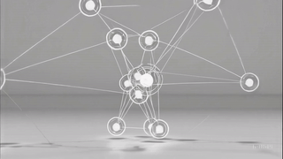

Slide 8
Road Map
Introduction
1
2
Motivation
Research Objectives
3
4
Background
Approach
5
6
Model Flowchart
Conclusion
7

Slide 9



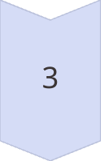
Citation Templates Revealing
Rationale
Recognizing common templates of citation evolution sheds light on discourse patterns and influential works.
Approach
Extract and analyse citation templates over time, identifying recurring styles and shifts in how works are cited. This framework helps track evolving trends and patterns in citation practices.
Expected Outcomes and Potential
Insights from citation templates enable more accurate classification of citation behaviours, help spotlight pivotal studies, and guide predictions about future research directions.

Slide 10
Road Map
Introduction
1
2
Motivation
Research Objectives
3
4
Background
Approach
5
6
Model Flowchart
Conclusion
7

Slide 11
Project Objectives
The approach focuses on three interconnected objectives, designed to build a comprehensive understanding of citation networks:
Dynamic Networks Evolution
Identify Patterns
Examine structure and evolution over time using embedding strategy.
Develop Scalable Models
Analyze node classifications within the citation dynamic network and be able to validate the results.
Create an efficient embedding model for large-scale analysis.

Slide 12
Road Map
Introduction
1
2
Motivation
Research Objectives
3
4
Background
Approach
5
6
Model Flowchart
Conclusion
7

Slide 13
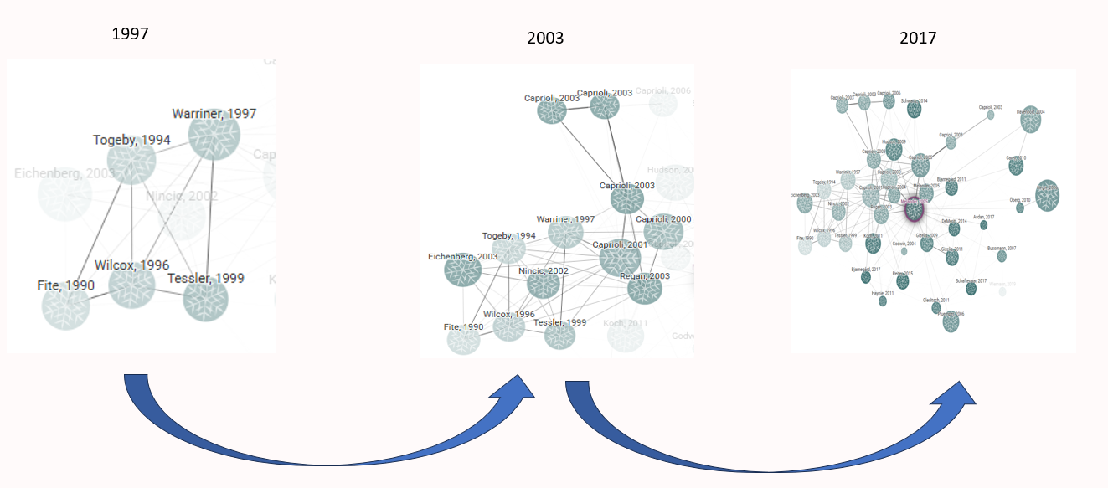
Dynamic Networks
1
Static Networks
2
Dynamic Networks
3
Temporal Changes
Static networks capture connections at a single point in time, lacking the evolution of relationships.
Dynamic networks capture evolving connections over time, showing how relationships change.
Key factors are node proximity and temporal continuity, showing closeness and consistent representation over time.

Slide 14
Dynamic Bernoulli Networks Embeddings
Dynamic Bernoulli embeddings are a novel approach in dynamic network analysis that aim to preserve the proximity and temporal continuity of nodes in a dynamic network. Dynamic Bernoulli embeddings utilize random walks to generate sequences of nodes.
Random Walk
1
Track the sequential context of nodes within the dynamic network.
Calculating Loss using Negative Sampling
2
Calculate loss elements and utilizing negative sampling.
3
Minimize Loss
Minimize the loss function using the SGD algorithm.
Context Update
4
Updating context vector to each node in the temporal graph.

Slide 15
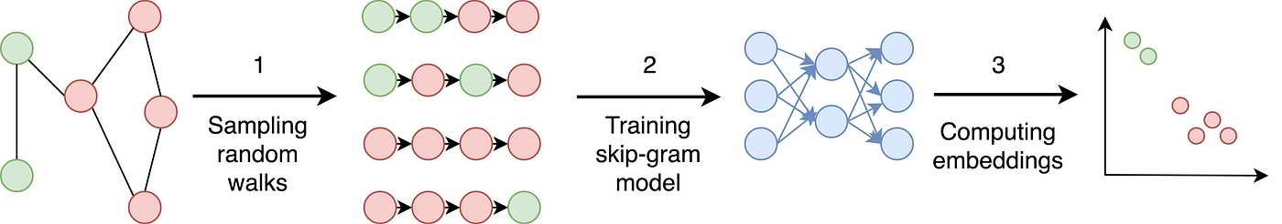
Random Walks for Network Exploration
What is a Random Walk?
Key Advantages
A random walk is a stochastic process that generates a path through a graph. At each step, the next node is chosen randomly from the current node's neighbors.
Enabling efficient sampling of large networks, especially when global computations are impractical or computationally expensive.
Random Walk vs. Probability
Each step to a neighbouring node is determined by probabilistic transitions. These probabilistic movements capture the co-occurrence frequencies of nodes, which are then leveraged to learn robust low-dimensional embeddings.

Slide 16
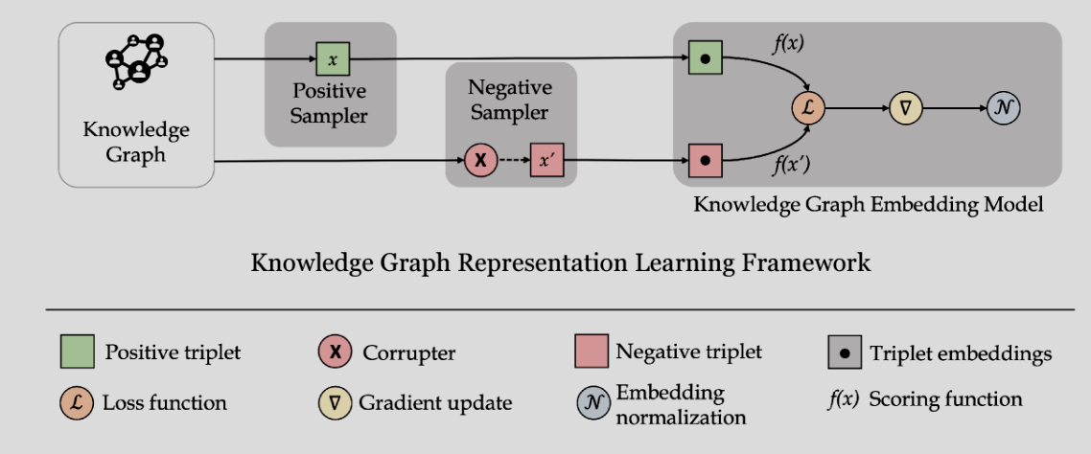

Learning Graphs By Sampling
Negative sampling is a pivotal technique for training embeddings in dynamic networks, as it helps algorithms distinguish real connections from noise at each time step. By selectively sampling non-existent edges, it reduces computational overhead and enhances the model’s ability to capture evolving relationships.
Citation
Graph
Citation Graph Embedding Model
$$ℒ =ℒ_{α}+ℒ_{pos}+ℒ_{neg}+ℒ_{y}$$
Citation Graph Representation Learning Framework

Slide 17
Road Map
Introduction
1
2
Motivation
Research Objectives
3
4
Background
Approach
5
6
Model Flowchart
Conclusion
7

Slide 18


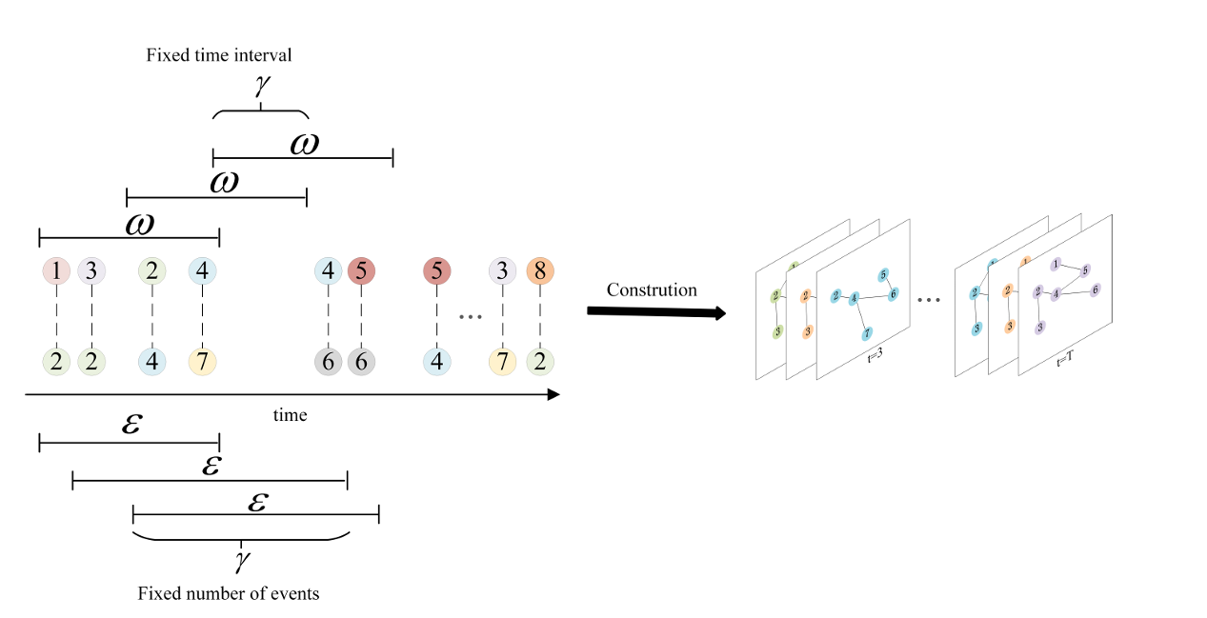
Approach
In a dynamic citation network, each article is represented as a node, and a directed edge signifies one paper citing another. Over time, new papers and citation links are added, capturing the evolving nature of academic influence and knowledge transfer. Two strategies for constructing the dynamic citation network :
Fixed Time Interval
Fixed Event Count
Create snapshots at regular time intervals, like monthly or yearly.
Construct networks based on a set number of citations, regardless of time.

Slide 19
Node Classification
Emerging Nodes
Nodes with recently increasing citations.
Rising Stars (Sleeping Beauty)
Emerging nodes with significant growth.
Steady Nodes
Nodes with consistent citation activity.
Falling Stars
Nodes with declining citation activity.

Slide 20
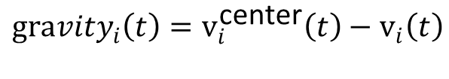
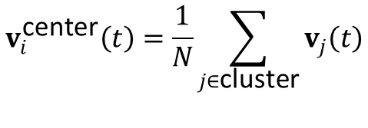
Classification Evaluation
Connectivity in dynamic networks is the ability to maintain communication despite changing topology.
The centroid in dynamic networks minimizes total distance to all nodes as topology changes.
Emerging Nodes
Steady Nodes
Rapid increase in connectivity
Steady connectivity over time
Rising Stars
Falling Stars
High gravity to centroid
Low gravity to centroid
$$v_{i}^{\text{center}}\left(t\right)=\frac{1}{N}\sum_{j∈\text{cluster}}{v_{j}\left(t\right)}$$
$$Δv_{i}=∥v_{i}\left(t+Δt\right)−v_{i}\left(t\right)∥$$
$${gravity}_{i}\left(t\right)=v_{i}^{\text{center}}\left(t\right)−v_{i}\left(t\right)$$

Slide 21
Road Map
Introduction
1
2
Motivation
Research Objectives
3
4
Background
Approach
5
6
Model Flowchart
Conclusion
7

Slide 22
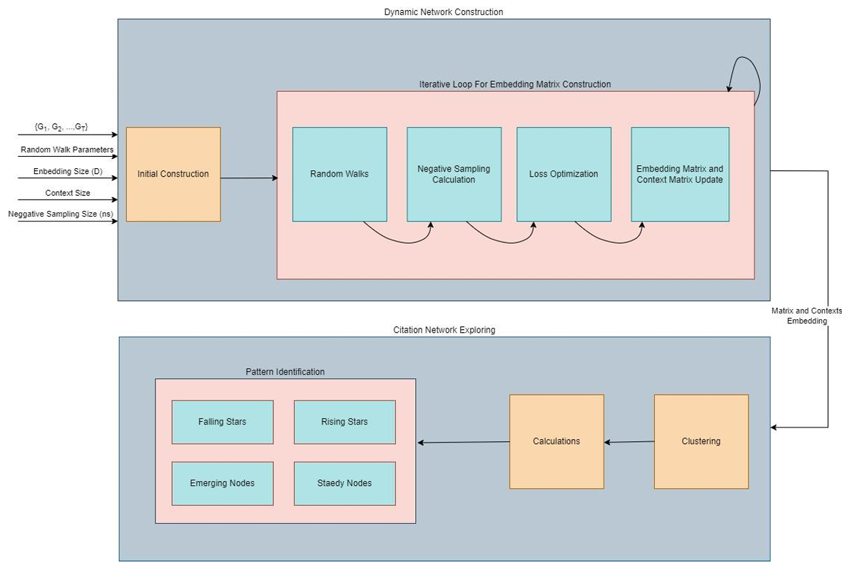
Model Flowchart

Slide 23
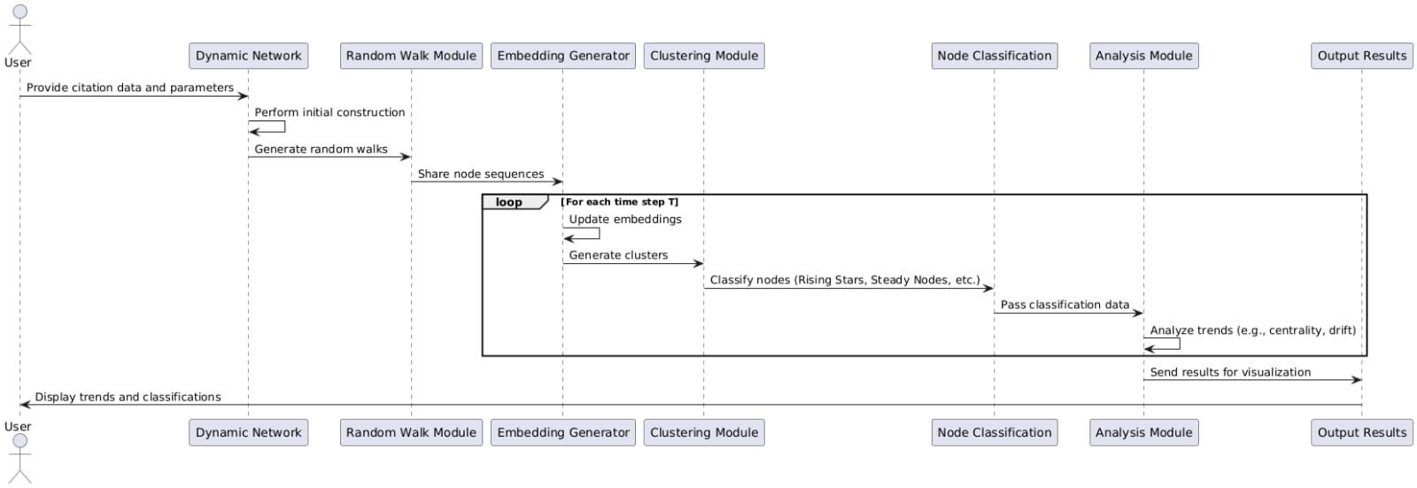
Sequence Diagram

Slide 24
Testing Plan
Unit Under Test | Test Case | Input | Expected Output
Dynamic Network | Network Construction with Fixed Time Intervals | Citation data split into yearly intervals. | Correctly structured networks for each year, with accurate nodes and edges.
 | Network Construction with Fixed Event Counts | Citation data with a specified number of events per snapshot. | Uniformly dense networks with appropriate overlaps.
Random Walk | Random Walks on Static Graphs | A static graph with defined edges. | Correct sequences capturing both local and global structures.
 | Random Walks on Dynamic Graphs | A dynamic graph with changing nodes and edges. | Sequences adapting to graph changes over time.
Embedding Generator | Embeddings for Static Nodes | Nodes with consistent relationships over time. | Stable embeddings with minimal drift.
 | Embeddings for Evolving Nodes | Nodes with rapidly changing connectivity. | Embeddings reflecting the change in proximity and influence.
Calculation and Classification | Classification of Rising Stars | Nodes with increasing centrality and connectivity. | Nodes correctly categorized as Rising Stars.
 | Classification of Falling Stars | Nodes with declining centrality and connectivity. | Nodes correctly categorized as Falling Stars.
 | Classification of Emerging and Steady Nodes | Nodes with new or consistent citation activity. | Accurate classification as Emerging or Steady Nodes.

Slide 25
Road Map
Introduction
1
2
Motivation
Research Objectives
3
4
Background
Approach
5
6
Model Flowchart
Conclusion
7

Slide 26



Future Steps
Approach Implementation
Citations Classification
Validation and Testing
Implement the proposed dynamic embedding framework approach and testing on real-world citation data.
Develop an efficient framework for node classification using the implemented approach.
Validate the framework's effectiveness by analyzing diverse citation networks.

Slide 27

Questions

Slide 28


